Slide 1
CSC120 Final
Brian Webb

Slide 2
Project Introduction
Task Manager Application:
Purpose: Allow users to keep track of their tasks.
Built Using:
Maven
Spring + Spring Boot + Lombok
Vaadin
MySQL

Slide 3
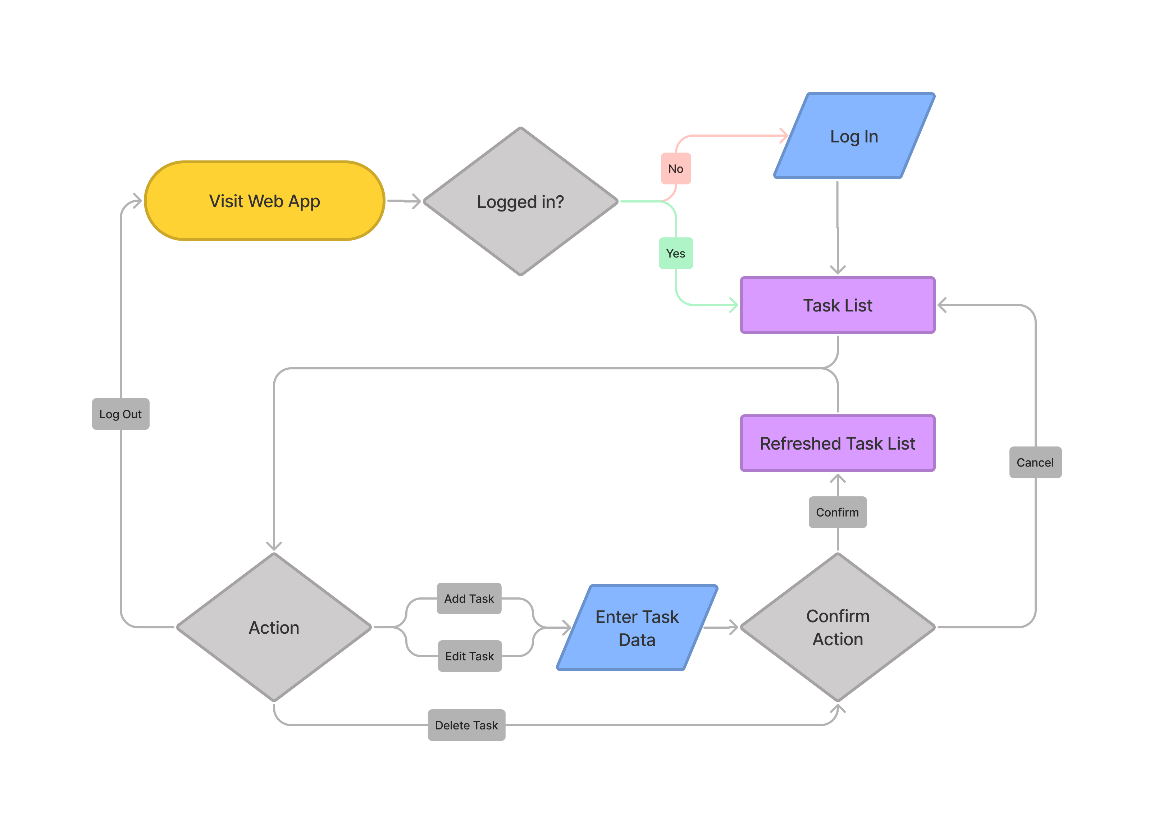
User Flow Diagram

Slide 4
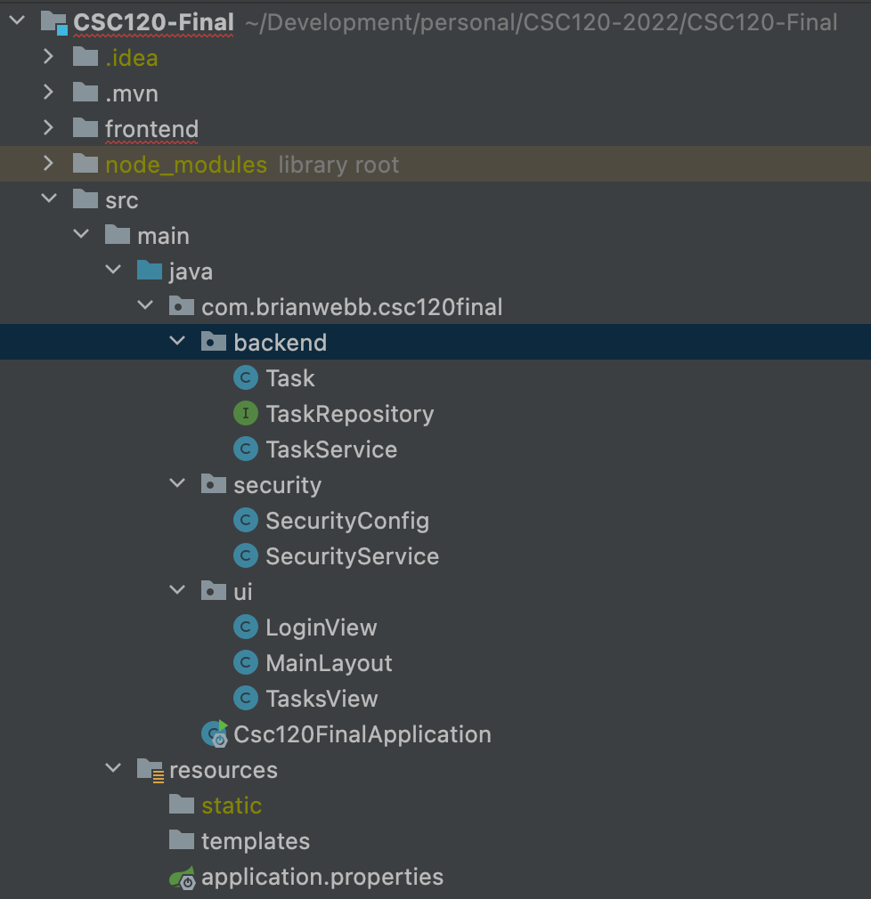
Application Code
Primary Pattern
Entity
Repository
Service

Slide 5
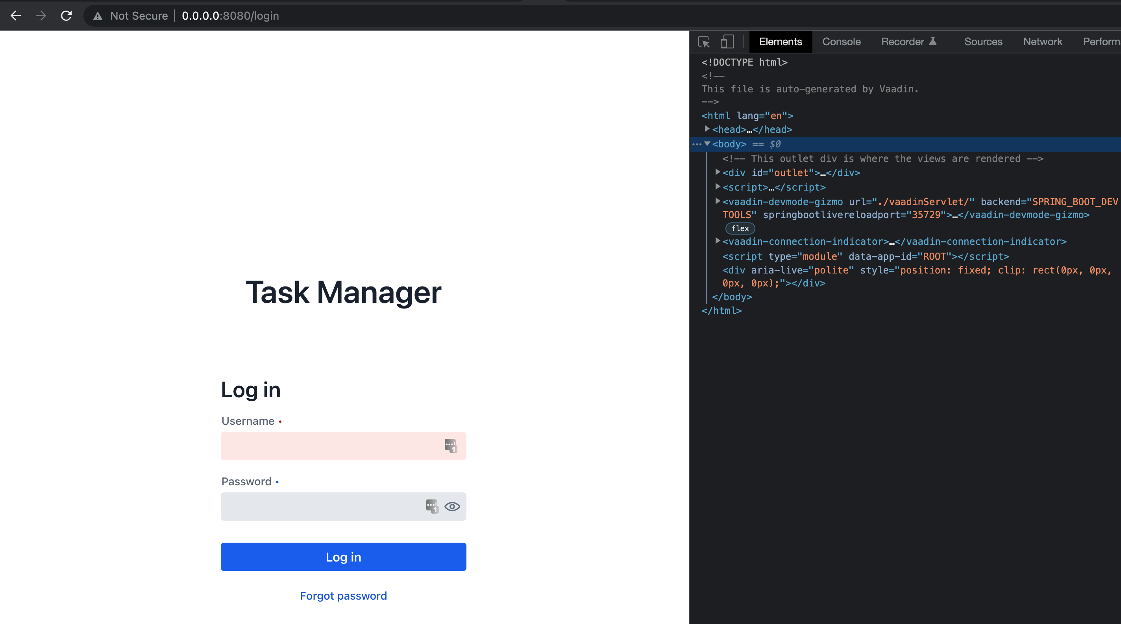
Tour

Slide 6
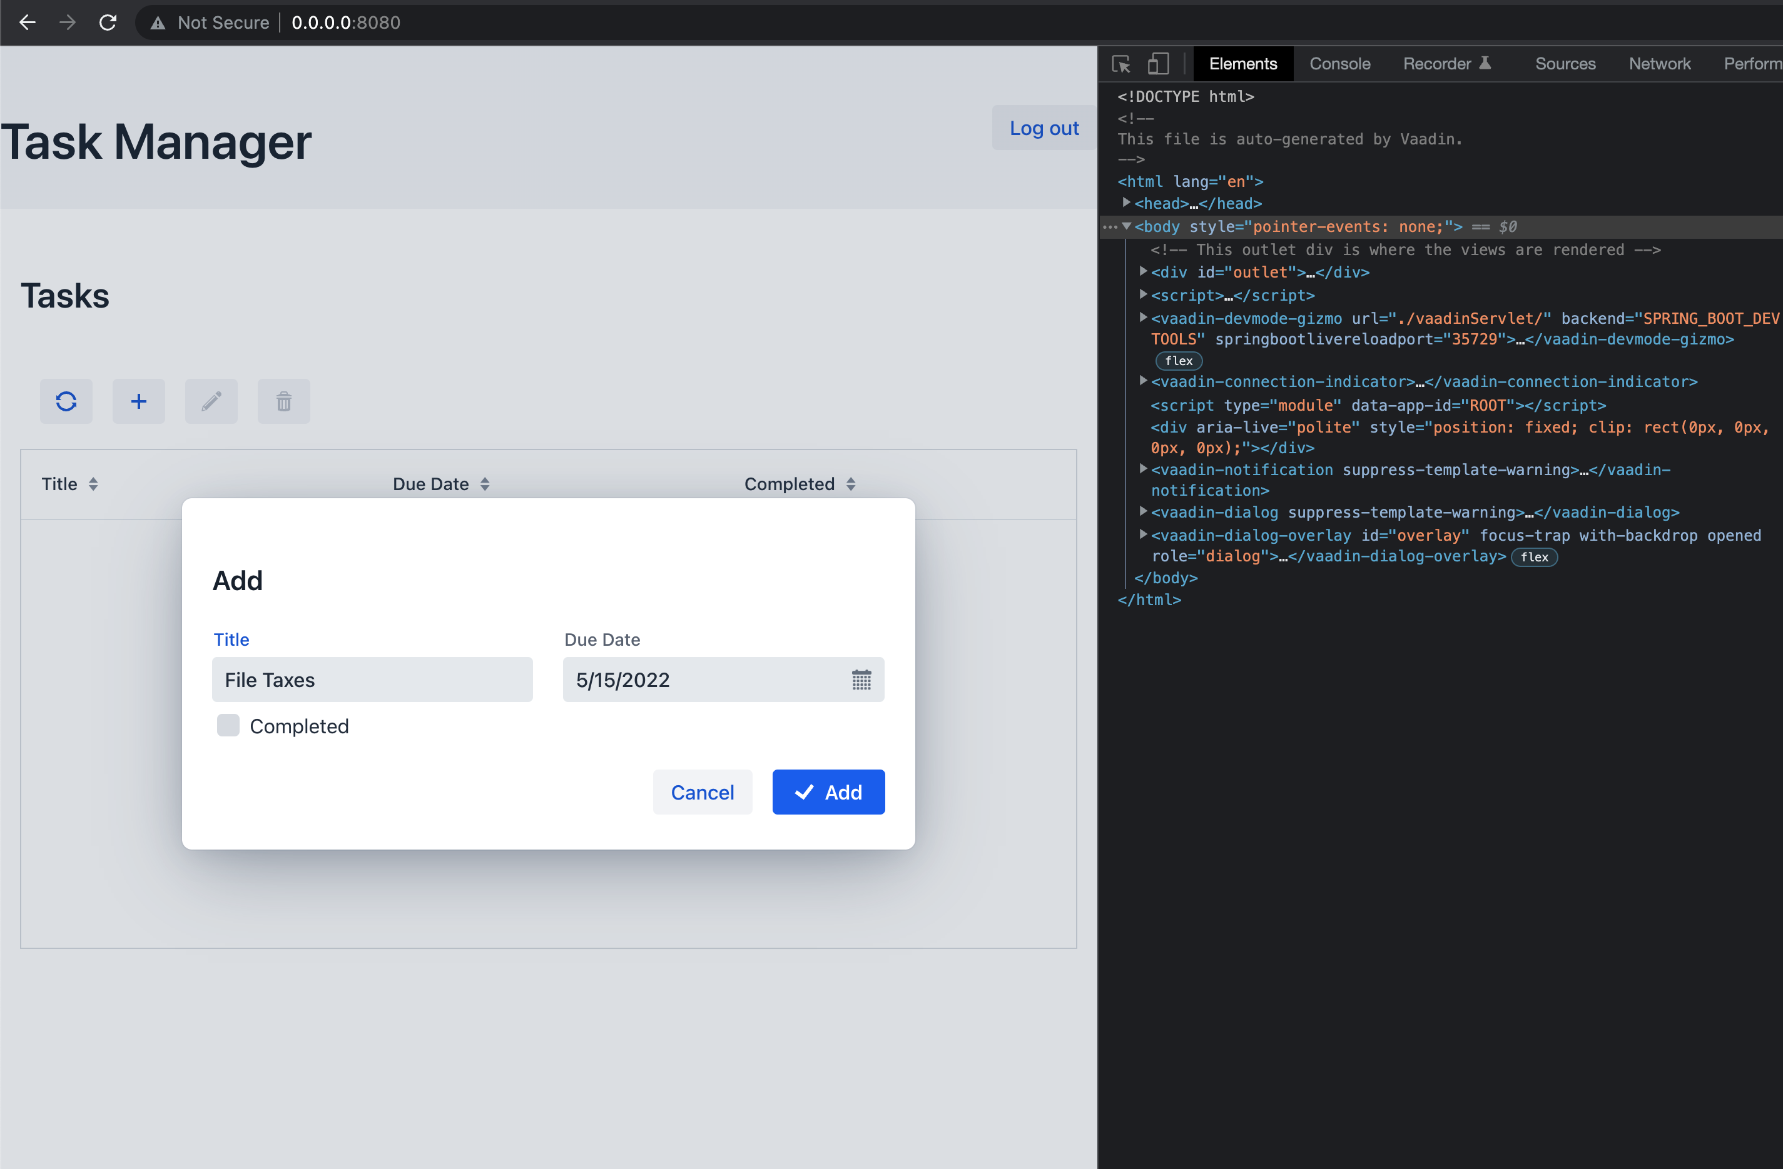

Slide 7
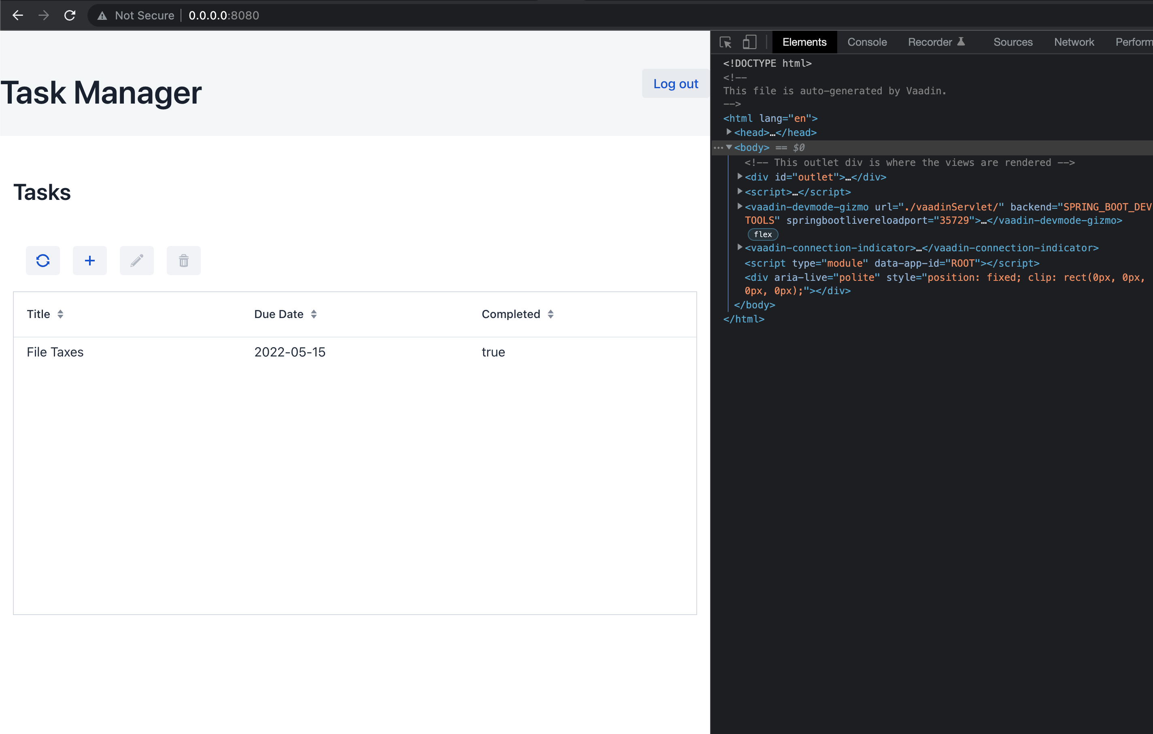

Slide 8
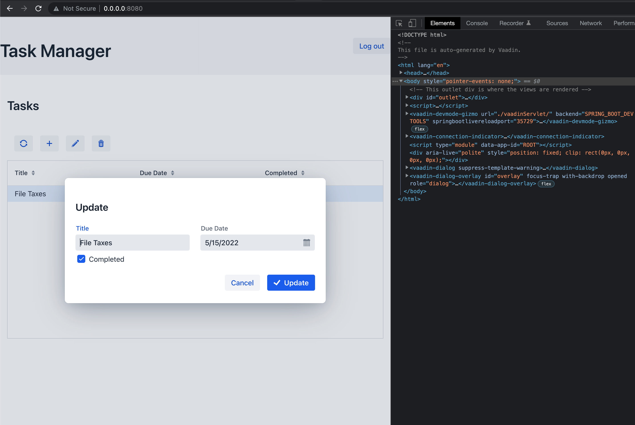

Slide 9
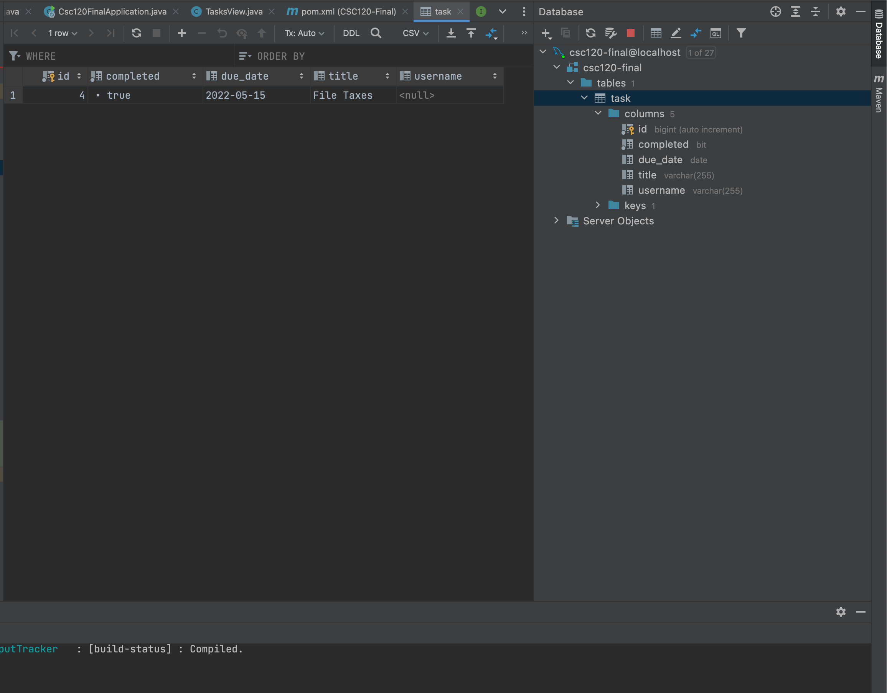

Slide 10
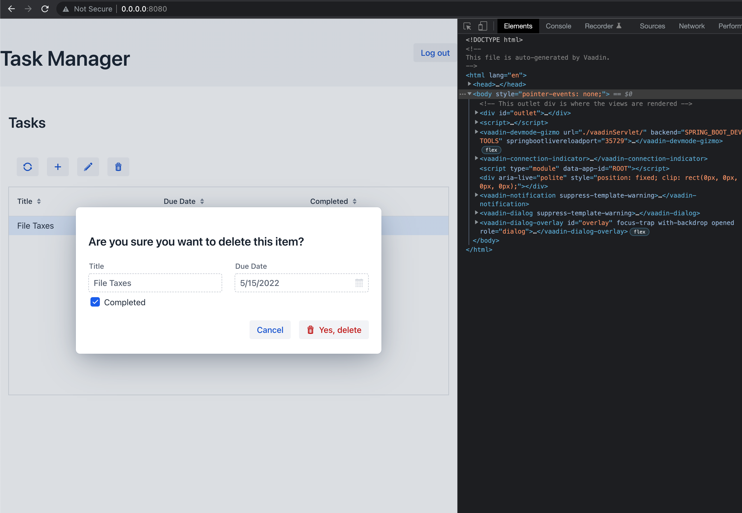

Slide 11
Running Locally
Github Repository: https://github.com/Brian-Webb/CSC120-2022/tree/main/CSC120-Final
Note: In order to run this application locally, you will need to have MySQL running and update src > main > resources > application.properties with your DB config credentials.

Slide 12
Next Steps
Implement Full User Authentication
Task -> User Relation
Upgraded User Interface

